Slide 1
Data type: string
January 10th, 2017
Programming Club

Slide 2
Before String: Character
What is a character?
‘1’ ‘2’ ‘3’
‘A’
‘a’
‘?’
‘\n’
‘ ’

Slide 3
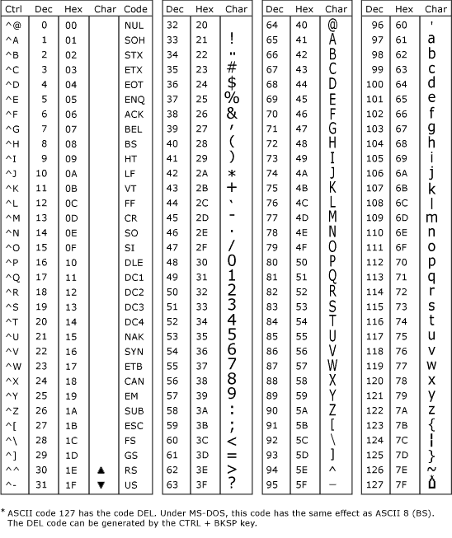
ASCII Character Codes Chart

Slide 4
What is a string?
String is actually a character array:
Ex.
“ABCDEFG”
“Hello world!”
“Hi, My name is …”

Slide 5
Define character type in C++
char ch; //define one character
ch = ‘A’; //give value to character
ch = ‘a’;
ch = ‘2’;
ch = ‘\n’;
ch = ‘ ’;
char ch[1024]; //define a character array
ch[1] = ‘A’; //give value to character array
ch[2] = ‘a’;
ch[3] = ‘2’;
ch[4] = ‘\n’;
ch[5] = ‘ ’;

Slide 6
Define string in c++
string s; //define a new string
s = “Hello, world!” // be sure to use “” for string, ‘’ for character
cin >> s; // input a string
cout << s << endl; // output a string

Slide 7
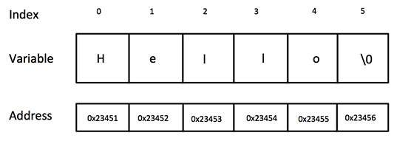
Because string is an array…

Slide 8
Ex.
string s = “Hello world!”
If we want to know which character is on the position 3,
cout << s[3] << endl; // Ans: ‘l’

Slide 9
basic member functions in C++ string
string s;
int len = s.size(); // find the length of string(# of characters inside the string)
bool flag = s.empty(); // return value: true of false represent if the string is empty
s.clear(); // clean all the elements in side the string
s.erase(pos, len) //pos: postion of the first character to be erased. Num: number of characters to erase
string substring = s.substr(pos, len); //pos: postion of the first character to be copied as a substring. Num: number of characters to include in the substring
Add two strings: s1& s2;
What’s s1 + s2?
s1 + s2 = put s2 behind s1.

Slide 10
An easy practice
Now you need to write code to introduce you to the world. Your task needs to include following functions:
Input your name
print your name
print your name one character per line
Print your first name, last name, grade, school, each character per line.
print your first name, space, last name, space, grade, space, school. (Ex. Ronny Chen 11 Pittsford Sutherland High School )

